Slide 1
INSECT PEST CLASSIFICATION AND RECOMMENDATION OF PESTICIDES USING RANDOM FOREST ALGORITHM
Ukeshwaran G (210701295)
Vasikaran G (210701305)
Vishwa N (210701315)

Slide 2
AGENDA
ABSTRACT
EXISTING SYSTEM
PROPOSED SYSTEM
ARCHITECTURE
MODULES
RESULTS AND DISCUSSION
CONCLUSION
FUTURE ENHANCEMENTS

Slide 3
ABSTRACT
In agriculture, Insect pests poses a significant threat to crop production. Crop production can be increased by protecting crops from these insects. Accurate identification of these pests is crucial for using the right pesticide. The goal of this project is to classify Insect pest and suggest pesticides to farmers. To classify insect pest we use Convolutional neural network and Random Forest Algorithm.

Slide 4
EXISTING SYSTEM
The pest detection system which has been mentioned in the base paper
“Large-Scale Insect Pest Image Classification using Deep learning” by Thanh-Nghi Doan uses convolutional neural network for extracting features from the insect image dataset and then the CNN model is trained on the extracted features. Since the system uses only neural networks for predicting the type of insect pest, it uses a larger number of neural network layers which makes the system computationally expensive and also increases the computation time.

Slide 5
PROPOSED SYSTEM
The proposed system utilizes Convolutional Neural Network to extract the features from the image which is then used as the input to train the Random Forest Algorithm. The Random Forest Algorithm is used to classify insect pest based on the input image which is uploaded by the user and recommends suitable pesticide for the pest. Since the system uses convolutional neural network only for feature extraction it greatly reduces the computational time required since only lesser number of neural network layers are used as compared to the existing system.

Slide 6
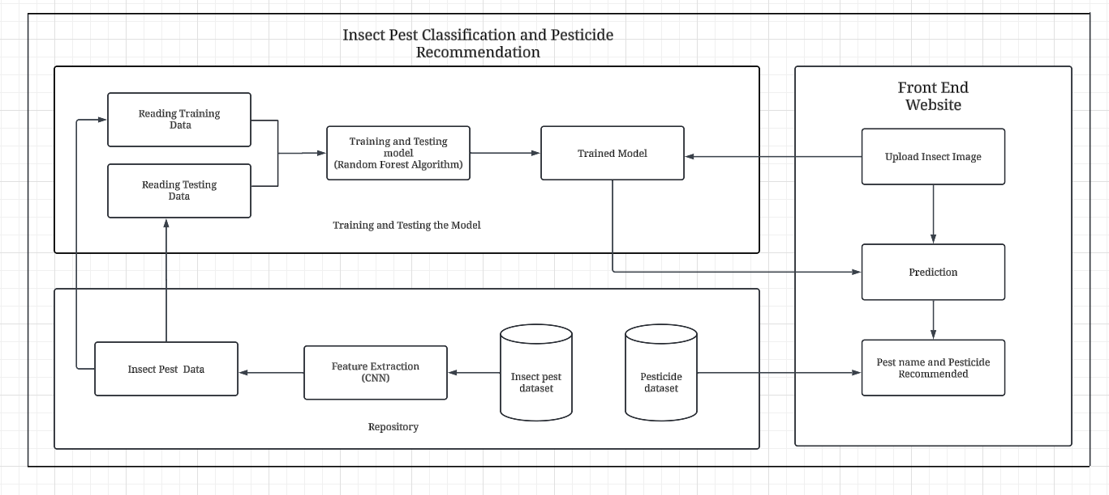
ARCHITECTURE

Slide 7
MODULES
Data Collection
Data preprocessing and Feature Extraction
Training the Random Forest Classifier
Testing the Model
Recommend Pesticide

Slide 8
MODULES
Data Collection: The dataset containing images of various insect pest is collected from Kaggle. In total the dataset consist 10 different types of insect with 350 images for each type.
Data Preprocessing and Feature Extraction: The dataset is splitted into test and train sets. Then the data is passed to CNN where the CNN extracts various features from the images.
Training the Random Forest Classifier: The features extracted from the dataset is used to train the Random Forest Algorithm.

Slide 9
MODULES
Testing the Model: The trained model is tested using the test dataset to determine the performance of the model against unseen insect images.
Recommend Pesticide: Based on the image uploaded by the user as the input, the model determine the type of pest and recommend suitable pesticides.

Slide 10
RESULTS AND DISCUSSION
The solution suggested in the existing system, “Large-Scale Insect Pest Image Classification using Deep Learning,” which uses CNN for predicting the type of insect pest, has a prediction accuracy of 93%. In contrast, our proposed solution uses CNN for extracting features from the pest insect image dataset, and the extracted features are used as input to train the Random Forest Algorithm. Compared to the existing system, our solution has obtained an accuracy of 95%. The accuracy of the system can be further increased by training the model for more number of iterations but it will also increase the training time.

Slide 11
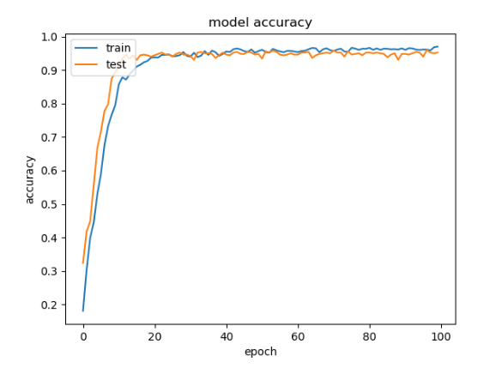
RESULTS AND DISCUSSION
Training and Testing Accuracy Graph:
The proposed model is evaluated and the testing and training accuracy graph is obtained. Splitting the dataset into training and validation sets (80:20).

Slide 12
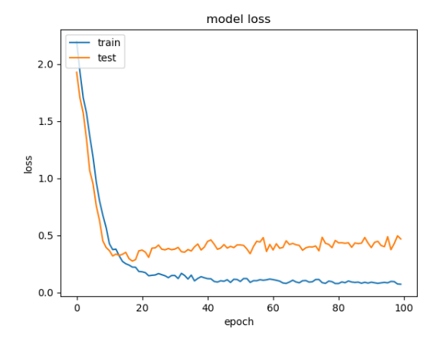
RESULTS AND DISCUSSION
Training and Testing Loss Graph:
The proposed model is evaluated and the testing and training loss graph is obtained. The training loss typically starts high and gradually decreases as the model learns the underlying patterns in the training data.

Slide 13
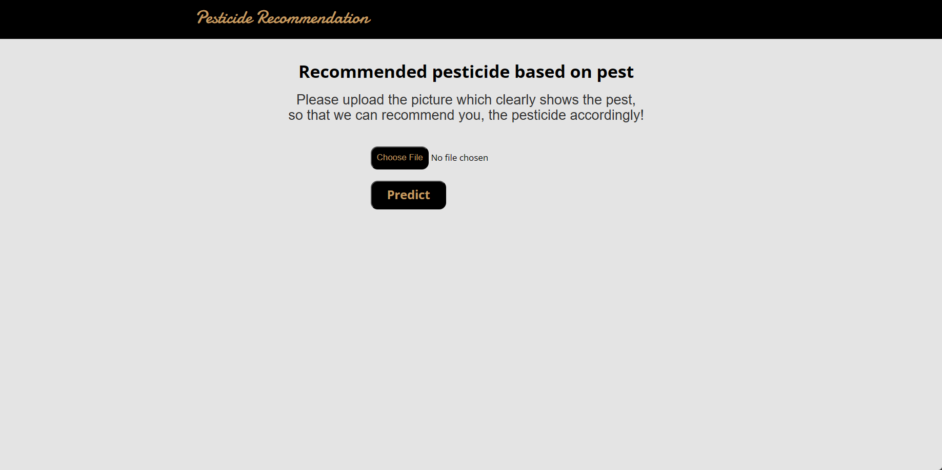
OUTPUT
Home page for user to upload insect image:

Slide 14
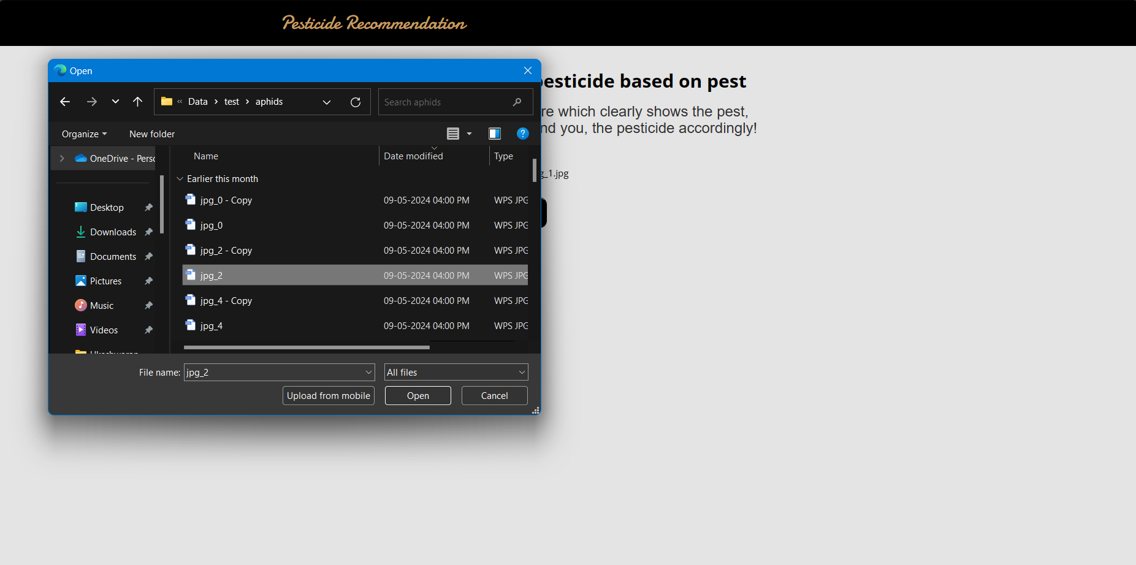
OUTPUT
User uploading insect image for prediction:

Slide 15
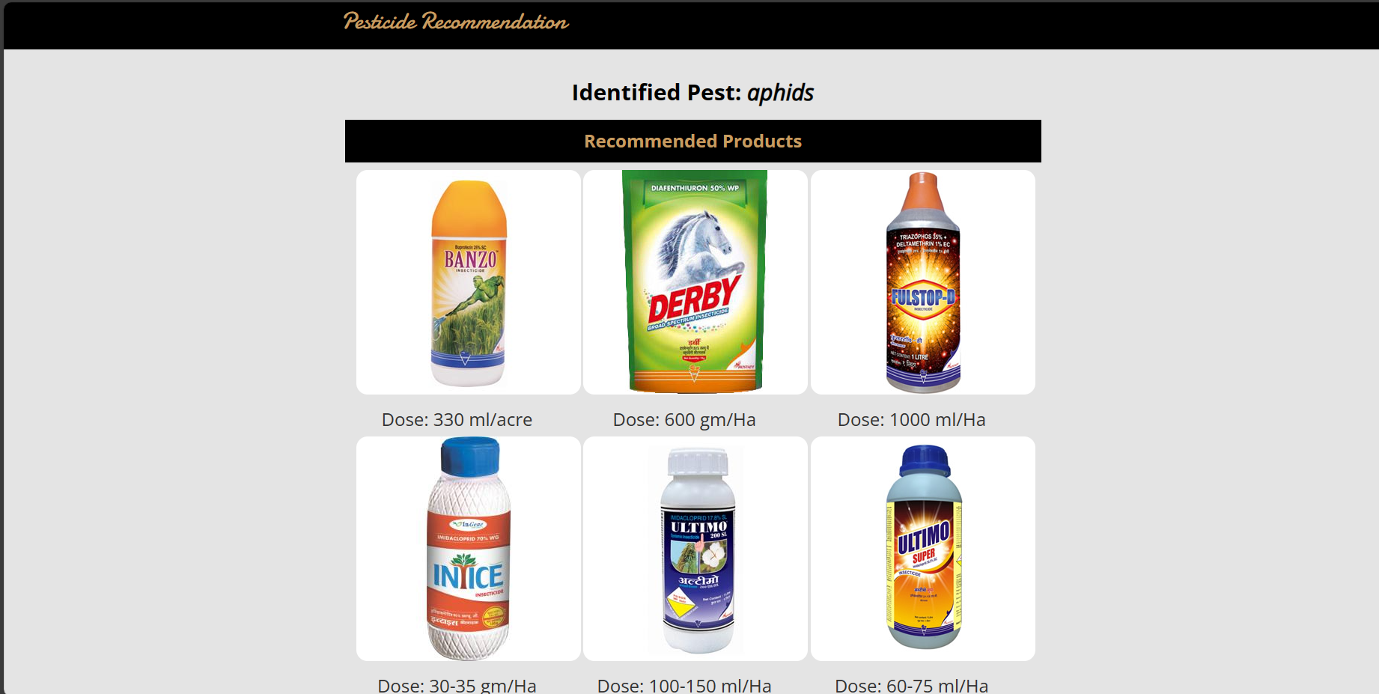
OUTPUT
Pesticide Recommendation based on insect:

Slide 16
CONCLUSION
In conclusion, the insect pest classification and pesticide recommendation presents a solution for agricultural pest management. By using Convolutional Neural Networks (CNNs) and Random Forest algorithms, this system identifies insect pests and provides suitable pesticide recommendations, improving crop yield and quality. The system provides a effective way to solve the challenge of identifying insect pests and using suitable pesticide for the corresponding insect.

Slide 17
FUTURE ENHANCEMENTS
Expansion of Dataset: Continuously updating the dataset with additional insect pest images from diverse geographic regions and training the model in updated data can improve the system's accuracy and can be used across various regions.
Real-time Monitoring: Implementing real-time monitoring systems using Iot can help to track insect pest and thus quick decisions can be made regarding pest control and further damage to the crop can be prevented.

Slide 18
THANK YOU

